Slide 1
Greedy Method

Slide 2
A greedy algorithm always makes the choice that looks best at the moment.
It makes a locally optimal choice in the hope that this choice will lead to a globally optimal solution.
Greedy algorithms do not always yield optimal solutions, but for many problems they do.

Slide 3
Fractional Knapsack Problem
We are given n objects and a bag or knapsack.
/ Object i has a weight w _{i} and
/ the knapsack has a capacity m.
/ If a fraction x _{I ,}0 ≤ x _{i} ≤ 1 of
Object i is placed into the bag then a profit of
p_{i} x _{i} is earned.
The objective is to obtain a filling of the knapsack that maximizes the total profit earned.

Slide 4
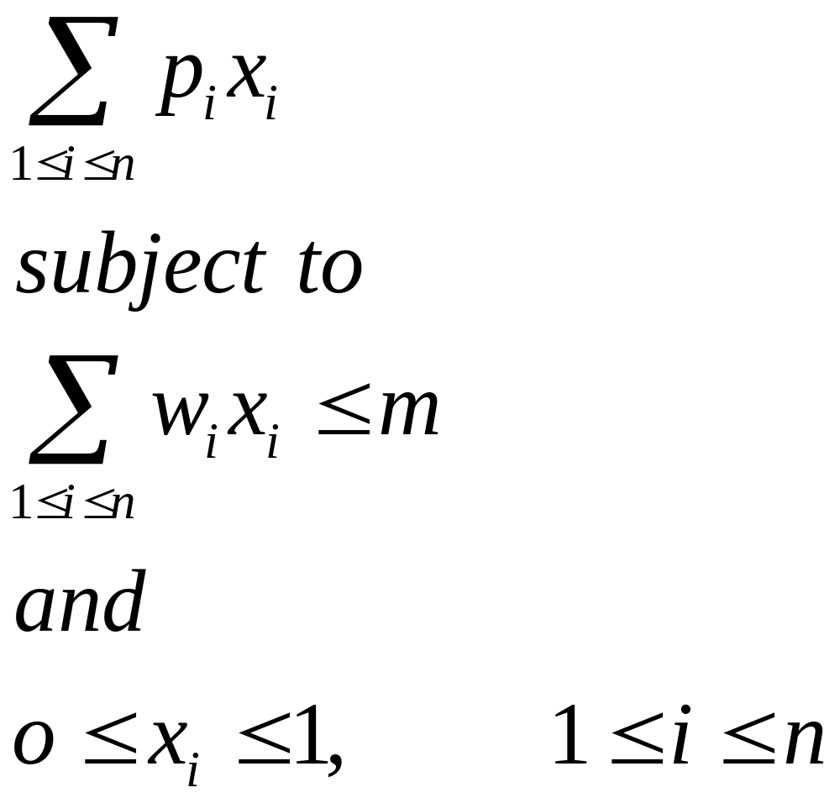
    Maximize
A feasible solution is any set ( x ₁ ,…. x _{n} ) satisfying the above inequalities. An optimal solution is a feasible solution for which objective function is maximized.

Slide 5
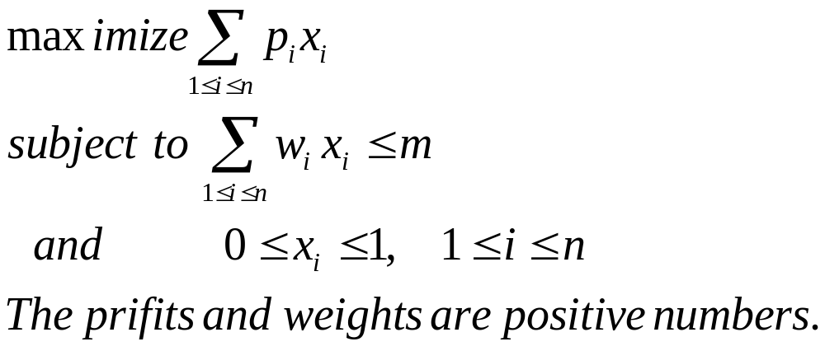
0-1 knapsack problem
Xi are o or 1

Slide 6
Greedy Algorithms for Knapsack Problem
Several simple greedy strategies are there.
We can fill the bag by including next object with largest profit.
Example: n= 3, m = 20,
(p₁ ,p ₂ , p ₃ ) = (25 , 24, 15)
(w ₁ , w ₂ , w ₃ ) = (18 , 15 , 10)
By above strategy solution is
X ₁ = 1 , x ₂ = 2/15, x ₃ = 0
Total weight = 20, profit = 28.2

Slide 7
But this solution is not the best one.
(0,1,1/2) is having profit 31.5

Slide 8
Another greedy approach
To become greedy w.r.t. capacity:
Start with lightest object and so on:
(0 ,2/3 , 1) with profit = 31
Again not an optimal solution.

Slide 9
New greedy approach
With a balance between weight and profit
At each step we include that object which has the maximum profit per unit of capacity used.
Using this strategy solution obtained is:
(0, 1 , ½) with profit = 31.5
Which is an optimal solution. For this example.

Slide 10
So this strategy gave optimal solution for this data:
In fact we can prove that this strategy will give optimal solution for any data.
Theorem: If p1 /w1 ≥ p2/ w2 ≥ …pn/wn .then selecting items w.r.t. this ordering gives optimal solution.
Proof: Let x = (x1 , …x n) be the solution so generated.
If all the xi’s are one then clearly the solution is optimal.
So let j be the least index such that xj ≠ 1.
So x i = 1 for all 1 ≤ i < j and
x i= 0 for j < i ≤ n and 0 ≤ xj <1.
Let y= (y1 , y2 ,…yn) be an optimal solution.
By obvious reasons Σwi yi = m

Slide 11
Let k be the least index such that yk ≠ xk.
It is easy to reason that yk < xk.
Now suppose we increase yk to xk and decrease as many of (yk+1, …. Yn) as necessary so that total capacity is still m.
This results in a new solution
Z = (z1 , z2, …zn)
where
zi = xi 1≤ i ≤ k
And
∑ wi (yi - zi ) = wk( zk – yk)
k <i≤n

Slide 12
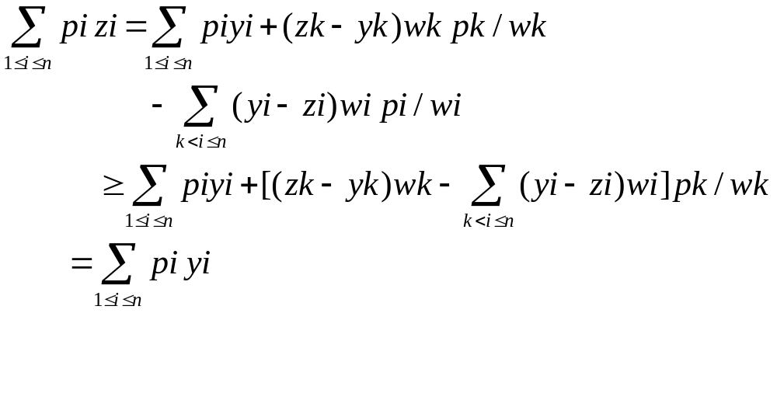
If Σ pi zi > Σ pi yi then y could not have been optimal solution.

Slide 13
If these sums are equal then either z = x and x is optimal or z ≠ x.
In the latter case repeated use of above argument y can be transformed into x and thus x too is also optimal

Slide 14
Minimum Spanning Tree problem
Kruskal’s Algorithm
Prim’s algorithm
Both are based on greedy algorithm
Algorithm and proof of getting optimal solution
Already done so revise or prepare your self

Slide 15
Huffman Codes
Very effective technique for compressing data; saving of 20% to 90%.
It uses a table of frequencies of occurrence of characters.

Slide 16
Fixed length code
If only three different characters are used in the text then we need 3 bits to represent six characters.
A=000; b= 001; …f=101.
This method thus requires 300,000 bits to code the entire file having 100,000 characters.

Slide 17
Variable Length code
We can do considerable better by giving frequent characters short code words and infrequent characters log code words.
frequency | 45 13 12 16 9 5
Fixed len codeword Var. length code | 000 001 010 011 100 101 0 101 100 111 1101 1100

Slide 18
Thus using variable length code it requires
(45.1 +13.3 12.3 16.3 9.4 5.4)1000 = 224,000
Bits
Thus saving approx 25%.
Prefix code: no code word is also a prefix of some other codeword.
These prefix codes are desirable because they simplify decoding. Like in our example
001011101 can be parsed uniquely as
0-0-101-1101 which decodes as aabe

Slide 19
Huffman Encoding
Compression
  Typically, in files and messages,
    Each character requires 1 byte or 8 bits
    Already wasting 1 bit for most purposes!
Question
  What’s the smallest number of bits that can be used to store an arbitrary piece of text?
Idea
  Find the frequency of occurrence of each character
  Encode Frequent characters short bit strings
  Rarer characters longer bit strings

Slide 20
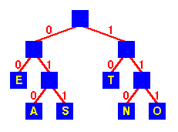
Huffman Encoding
Encoding
  Use a tree
  Encode by following
  tree to leaf
  eg
    E is 00
    S is 011
  Frequent characters
  E, T 2 bit encodings
  Others
  A, S, N, O 3 bit encodings

Slide 21
Huffman Encoding
Encoding
  Use a tree
    Inefficient in practice
  Use a direct-addressed lookup
  table
Finding the optimal encoding
  Smallest number of bits to
  represent arbitrary text
A
010
B
:
E
00
:
N
110
:
S
001
T
10

Slide 22

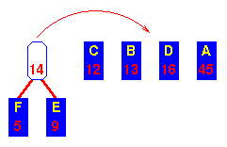
Huffman Encoding - Operation
Initial sequence
Sorted by frequency
Combine lowest two
into sub-tree
Move it to correct
place

Slide 23
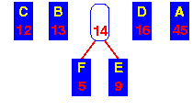
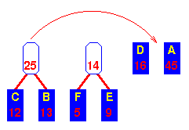
Huffman Encoding - Operation
After shifting sub-tree
to its correct place ...
Combine next lowest
pair
Move sub-tree to
correct place

Slide 24
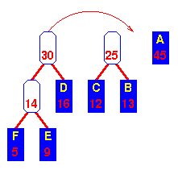
Huffman Encoding - Operation
Move the new tree
to the correct place ...
Now the lowest two are the
“14” sub-tree and D
Combine and move to
correct place

Slide 25
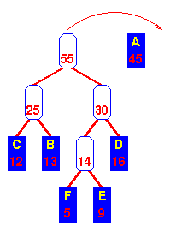
Huffman Encoding - Operation
Move the new tree
to the correct place ...
Now the lowest two are the
the “25” and “30” trees
Combine and move to
correct place

Slide 26
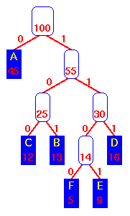
Huffman Encoding - Operation
Combine
last two trees

Slide 27
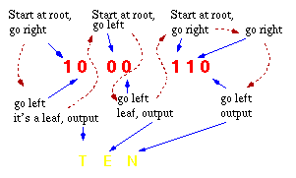
Huffman Encoding - Decoding

Slide 28
Huffman Encoding - Time Complexity
Sort keys O(n log n)
Repeat n times
  Form new sub-tree O(1)
  Move sub-tree O(logn)
  (binary search)
  Total O(n log n)
Overall O(n log n)

Slide 29
Theorem
Let C be an alphabet in which each character c of C has frequency f(c ) .
Let x and y be two characters in C having lowest frequencies.
Then there exists an optimal prefix code for C in which the code words for x and y have the same length and differ only in the last bit.

Slide 30
T:
T’:
a
x
y
y
a
b
x
b
Let a and b be two characters that are sibling leaves of maximum depth in T.
We can assume f(a) ≤ f(b) and f(x) ≤ f(y)
Since x and y are of lowest frequencies
f(x) ≤ f(a) and f(y) ≤ f(b)

Slide 31
T’’:
a
b
x
y

Slide 32
The number of bits required to encode a file is
B(T) = ∑f (c ) d _{T}(c)
we can call it the cost of the tree T.
B(T) – B(T’) = ∑f (c ) d _{T}(c) - ∑f (c ) d _{T’}(c)
= f(x) d_{T}(x) + f(a) d_{T}(a) - f(x) d_{T}’(x) – f(a) d_{T}’(a)
= f(x) d_{T}(x) + f(a) d_{T}(a) - f(x) d_{T}(a) – f(a) d_{T}(x)
=(f(a) – f(x))(d_{T}(a) – d_{T}(x))
>= 0 because both
f(a)-f(x) and d_{T}(a) – d_{T}(x) are nonnegative.

Slide 33
Similarly exchanging y and b does not increase the cost so
B(T’) - B(T’’) is non negative.
There fore
B(T’’) ≤ B(T)
And since T was taken to be optimal
B(T) ≤ B(T’’)
Which implies
B(T’’) =B(T)
Thus T’’ is an optimal tree in which x and y appear as sibling leaves of maximum depth.

Slide 34
Theorem - Let C be a given alphabet with frequency f(c). Let x and y be two characters in C with minimum frequencies. Let C’ be the alphabet obtained from C as
C’ = C-{x,y}∪{z}.
Frequencies for new set is same as for C except that f(z) = f(x) + f(y).
Let T’ be any optimal tree representing optimal code for C’, then the tree T obtained from T’ by replacing the leaf node for z with an internal node having x and y as children, represents an optimal prefix code for the alphabet C

Slide 35
Proof: For any c ε C – {x ,y}
d_{T}(c ) = d_{T}’(c ) but for x and y
d_{T}(x) = d_{T}(y) = d_{T}’(z) + 1
We have
f(x)d_{T}(x) + f(y) d_{T}(y) = (f(x) + f(y) )(d_{T}(z) + 1)
= f(z) d_{T}(z) + (f(x) + f(y))
B(T) = B(T’) + f(x) + f(y)

Slide 36
From which we conclude that
B(T) = B(T’) + f(x) + f(y)
Or
B(T’) = B(T) – f(x) – f(y)
We now prove by contradiction.
Suppose that T is not optimal for C then there is another optimal tree T’’ such that
B(T’’) < B(T)
Without any loss of generality we can assume that x and y are siblings here.
Let T’’’ be the tree obtained from T’’with the common parent of x and y replaced by a leaf z with freq f(z) = f(x) +f(y)
then

Slide 37
B(T’’’) = B(T’’) – f(x) – f(y)
< B(T) – f(x) – f(y)
=B(T’)
This contradicts the assumption that T’ represents an optimal prefix code for C’
Thus T must represent an optimal prefix code for the alphabet C.

Slide 38
Job Sequencing with dead lines
We are given n jobs, associated with each job i there is an integer deadline d_{i} ≥ 0 and a profit p_{i} >0.This profit pi will be earned only if job is completed before its deadline.
Each job needs processing for one unit time on a single machine available.
Feasible solution-is a subset of jobs each which can be completed without crossing any deadline.
Optimal solution is that feasible solution with maximum profit

Slide 39
Example: n=4 , p=(100,10,15,27) and d=(2,1,2,1)
Possible feasible solutions:
Subset sequence value
(1,2) 2,1 110
(1,3) 1,3 or 3,1 115
(1,4) 4,1 127
(2,3) 2,3 25
(3,4) 4,3 42
(1) 1 100

Slide 40
Greedy approach
objective is to maximize ∑pi
So next job to select in J is the one that increases
∑pi the most, subject to the restriction that set J is feasible.
Feasibility test becomes very easy through the following result

Slide 41
Theorem: Let J be a set of k jobs and
S= i₁,i₂,….i_{k} a permutation of jobs in J such that d_{i1} ≤ d_{i2} ≤ ≤ d_{ik}. Then J is feasible iff the jobs in J can be processed in the order S without violating any deadline.
Proof:
We need to show that if J is feasible set then a permutation S =i1,i2 …ik with d_{i1} ≤ d_{i2} ≤ d_{ik} is also feasible.
If J is a feasible set then there exists S’ = r1, r2….rk such that d_{rq} ≥ q, 1 ≤ q ≤ k.
Assume s ≠ s’,

Slide 42
Let a be the least index such that ra ≠ ia.
Let i_{a} = r_{b} for some b > a
In S’ we can interchange r_{a} and r_{b} .since d_{ra} d_{rb} the resulting permutation s’’
S: i1 i2 . . . ia … ik
S’: r1 r2 ra rk
d_{ia}<=d_{ra}
Since S’ is feasible sequence
If we interchange ra and rb we get another feasible sequence. And new sequence is closer to S.
Continuing in this way S’ can be transformed into S without violating any dead line.
b

Slide 43
Theorem: greedy approach always obtains an optimal solution
Proof: Let I be the set obtained by greedy method.
And let J be the set of jobs in the optimal solution.
We will show that I and j have both have same profit values.
We assume that I ≠ J.
Also J cannot be subset of I as J is optimal
Also I can not be subset of J by the algo.

Slide 44
So there exists jobs
a in I such that a is not in J
And
b in J but not in I
Let a be a highest profit job such that a is in I and not in J.
Clearly pa ≥ pb for all jobs that are in J but not in I.
Since if pb > pa then greedy approach would consider job b before job a and included into I.
Let Si and Sj be the sequences for feasible sets I and J.

Slide 45
We will assume that common jobs of I and J are being processed in same time intervals.
Let i be a job scheduled to t to t+1 in S I and t’ to t’+1 in Sj
If t < t’ then interchange the job if any in [t’ , t’+1] in Si with job i.
Similarly if t’ < t similar transformation can be done in Sj

Slide 46
Now consider the interval [ ta, ta+1] in Si in which job a is scheduled.
Let b the job(if any) scheduled in Sj in this interval.
Pa ≥ pb from the choice of a
So scheduling a from ta to ta+1 in Sj and discarding job b gives a feasible schedule for the set j’ = j- {b} + {a}.
Clearly J’ has profit no less than that of J and differs from I in one less job than J does.
By repeatedly using this approach J can be transformed into I without decreasing the profit value.

